Slide 1

Retail Sales Analysis Dashboard
By: Arpit Vishwakarma
Data Analyst Portfolio Project
This Photo by Unknown Author is licensed under CC BY-SA

Slide 2
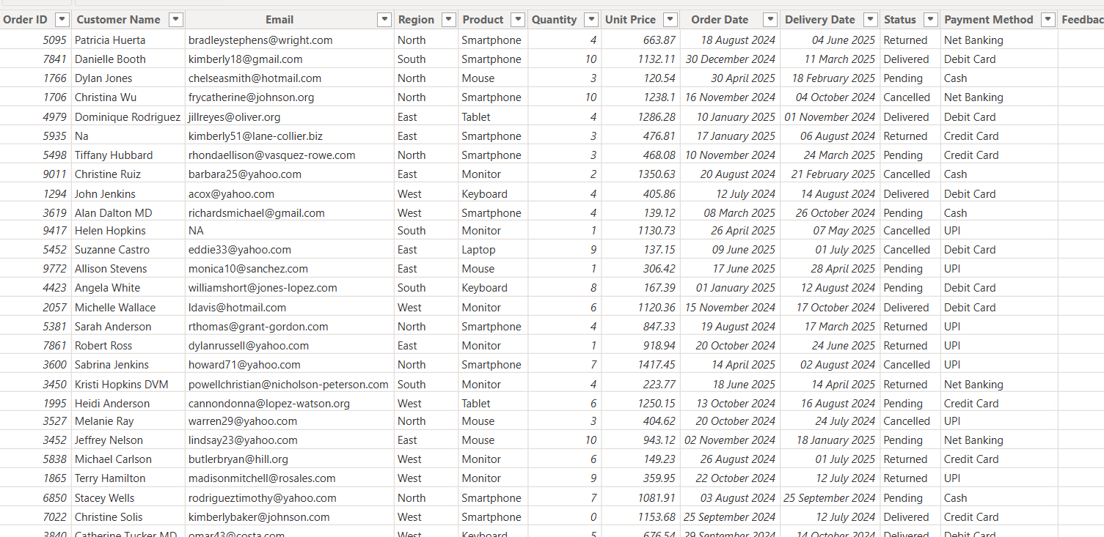
Row Data Of Retail Sales

Slide 3
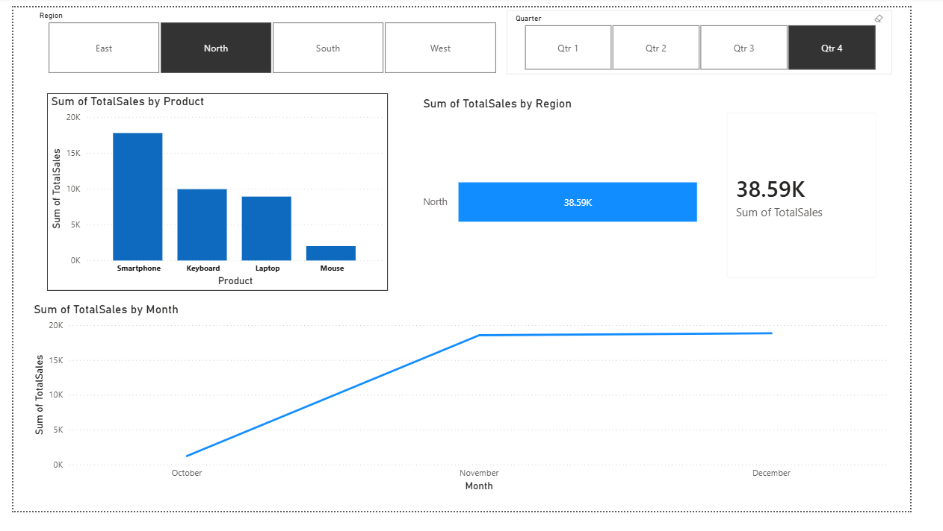

Slide 4
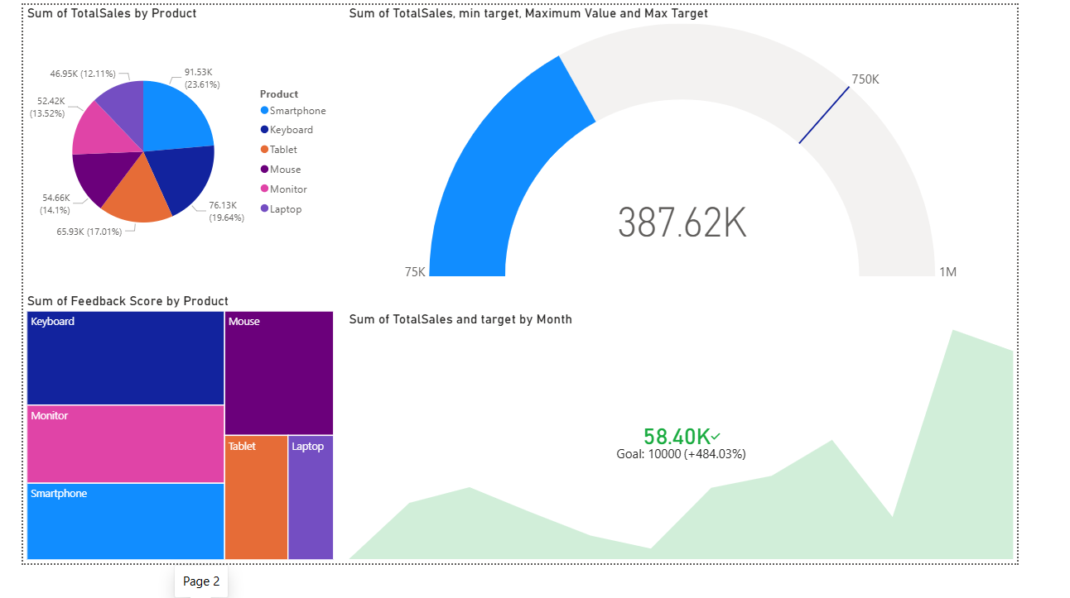

Slide 5
